Slide 1
XPath

Slide 2
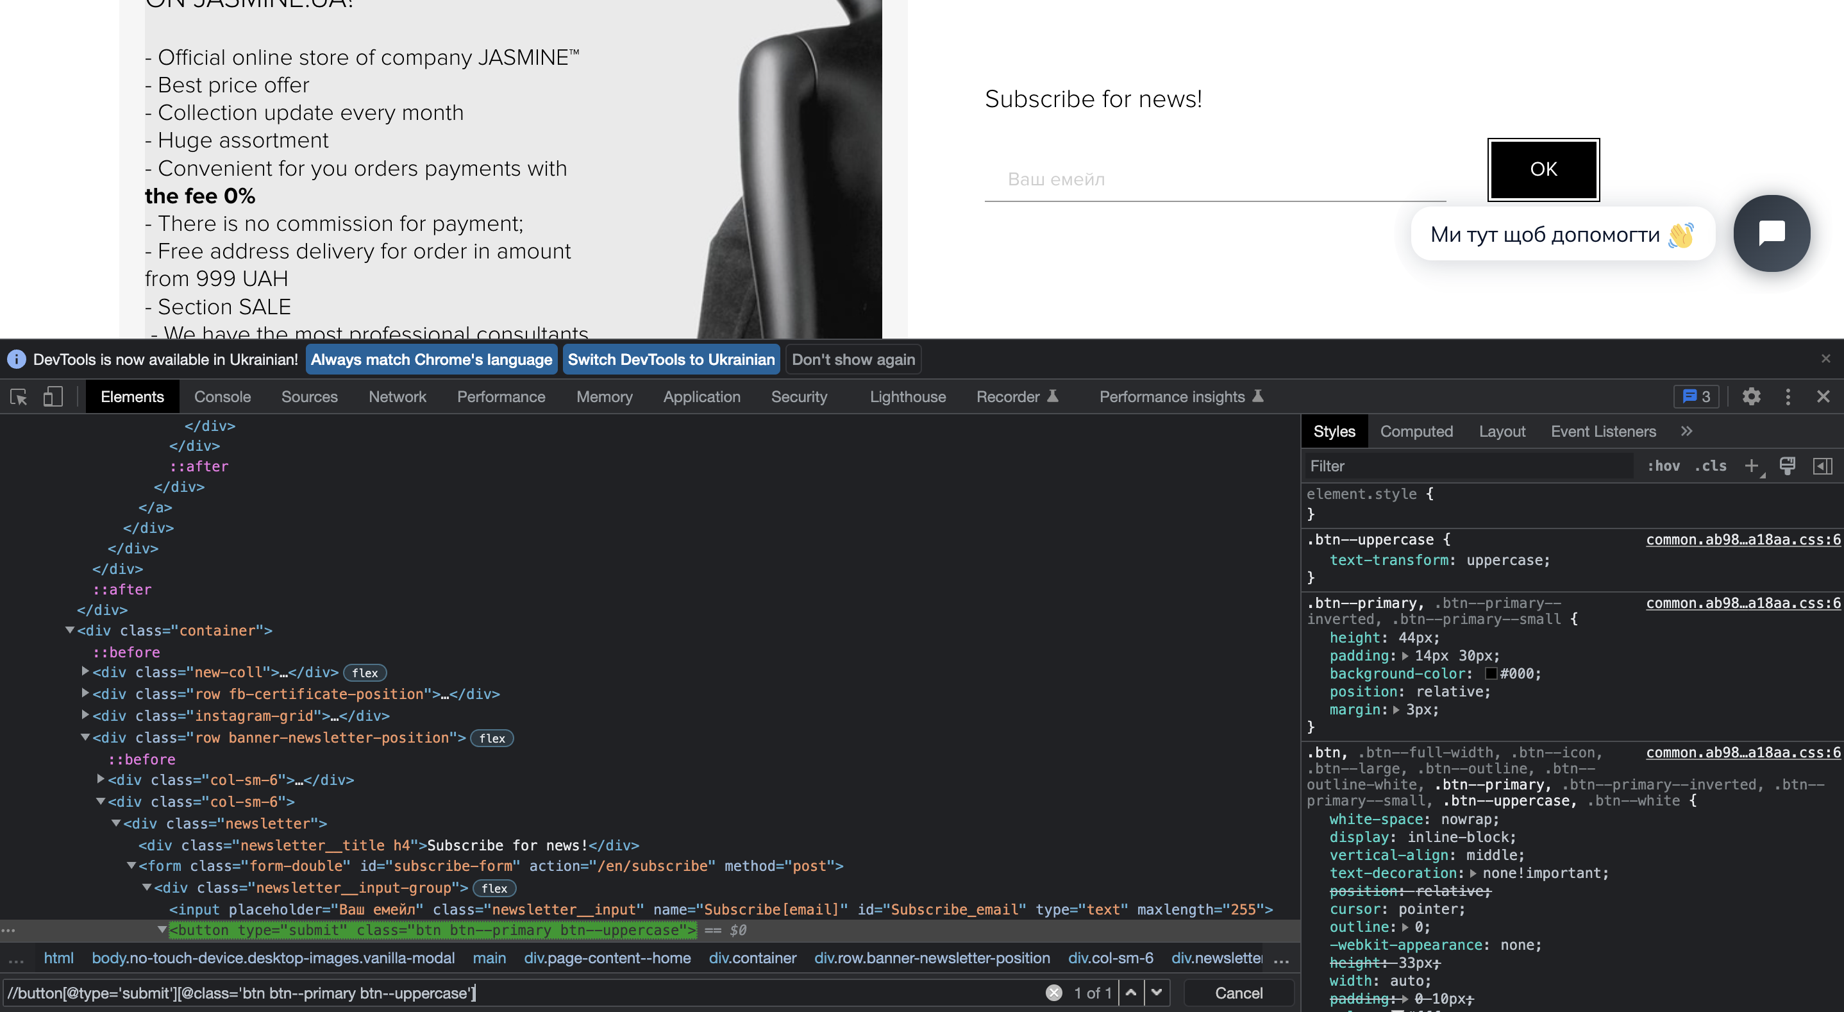
//button[@type='submit'][@class='btn btn--primary btn--uppercase']

Slide 3
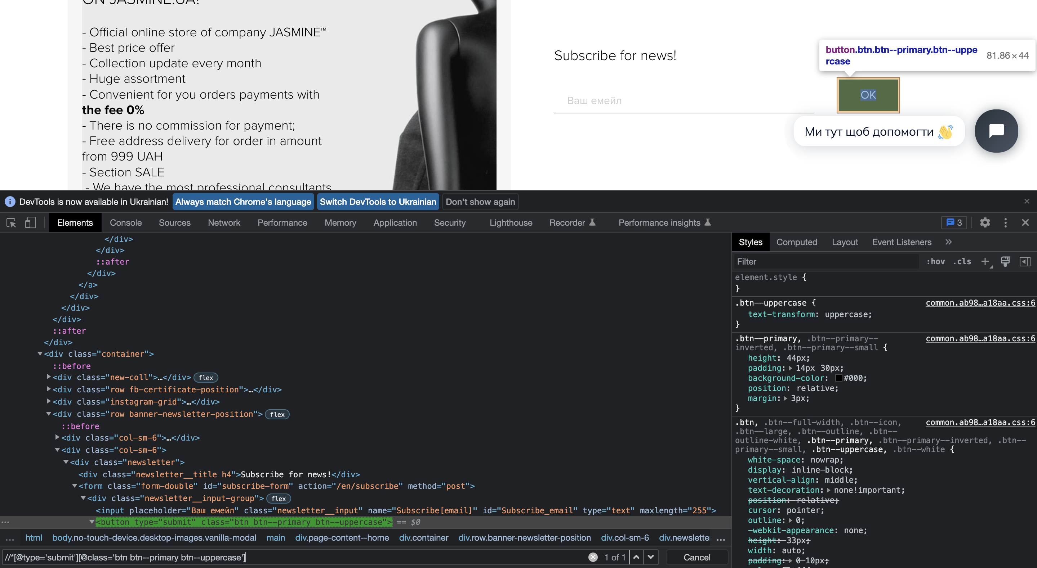
//*[@type='submit'][@class='btn btn--primary btn--uppercase']

Slide 4
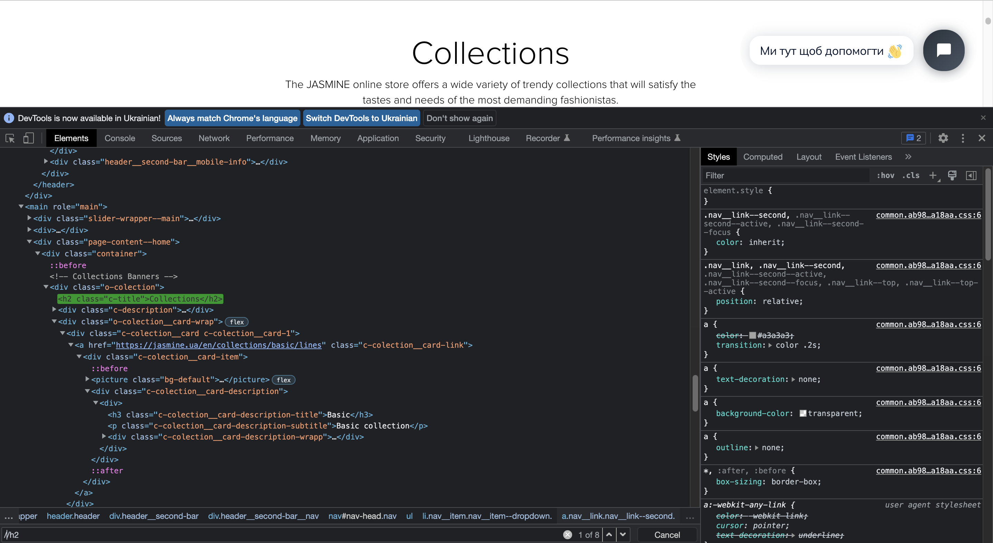
//h2

Slide 5
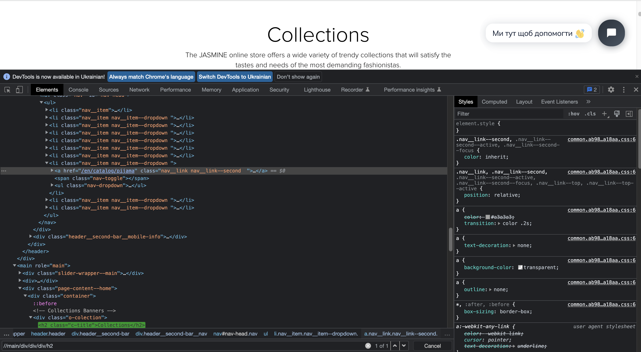
//main/div/div/div/h2

Slide 6
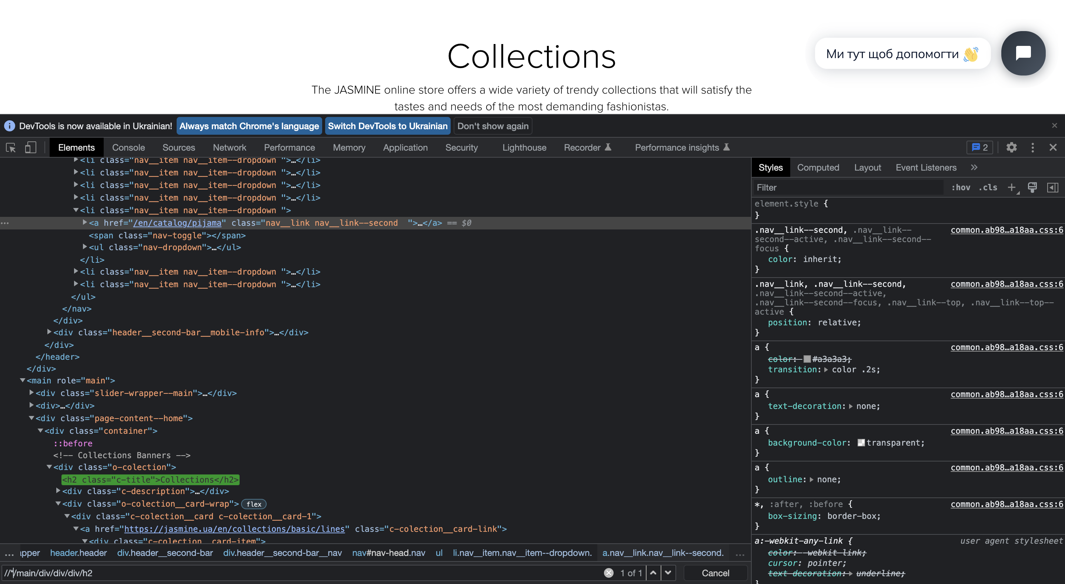
//*/main/div/div/div/h2

Slide 7
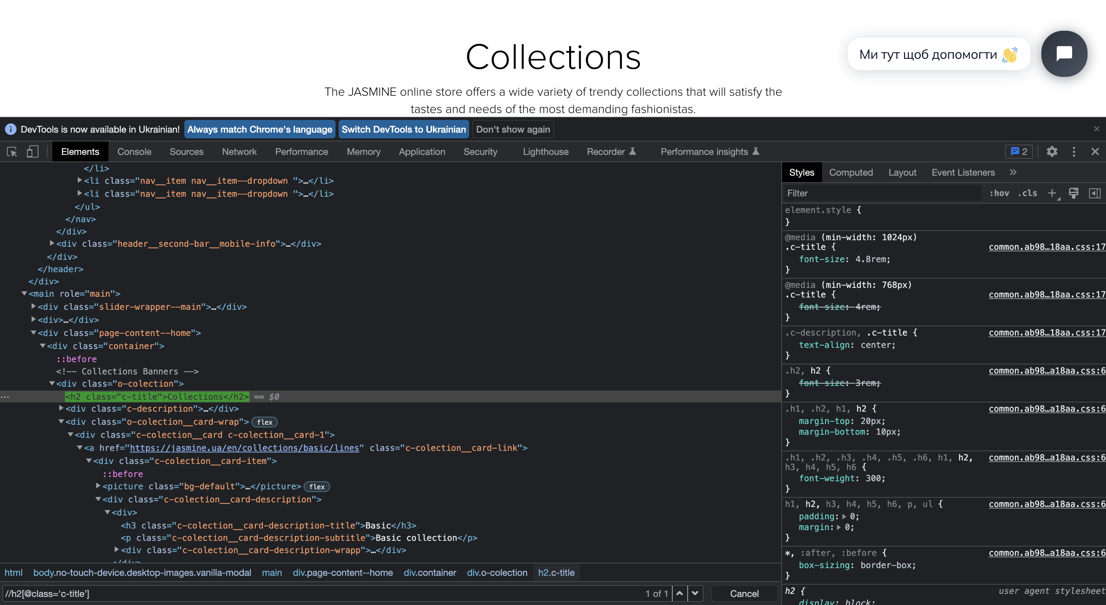
//h2[@class='c-title']

Slide 8
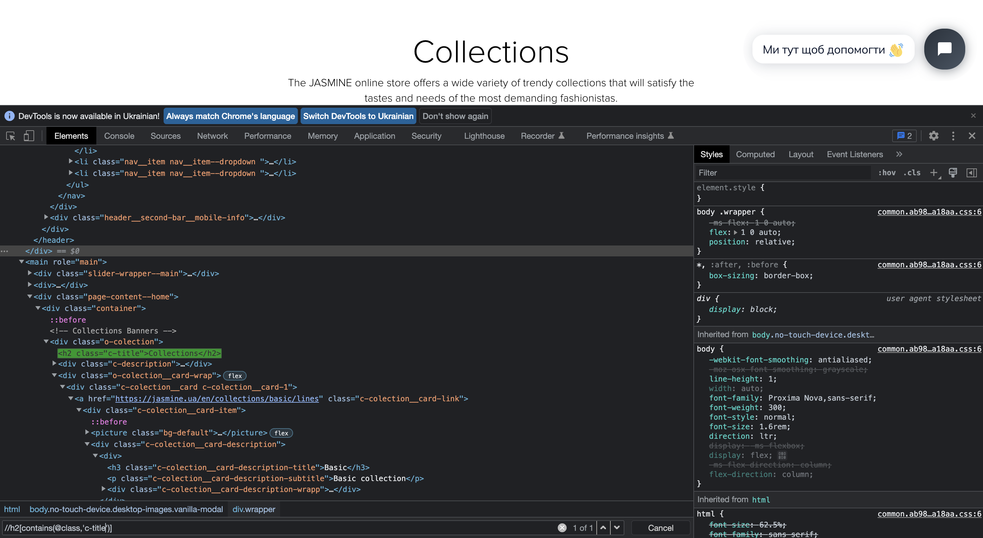
//h2[contains(@class,'c-title')]

Slide 9
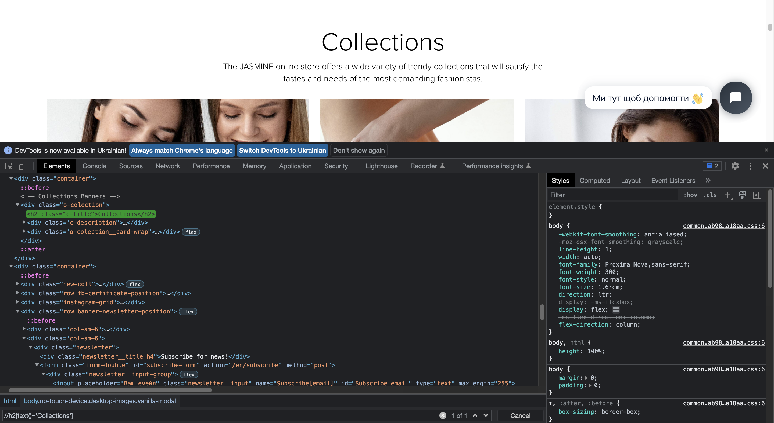
//h2[text()='Collections']

Slide 10
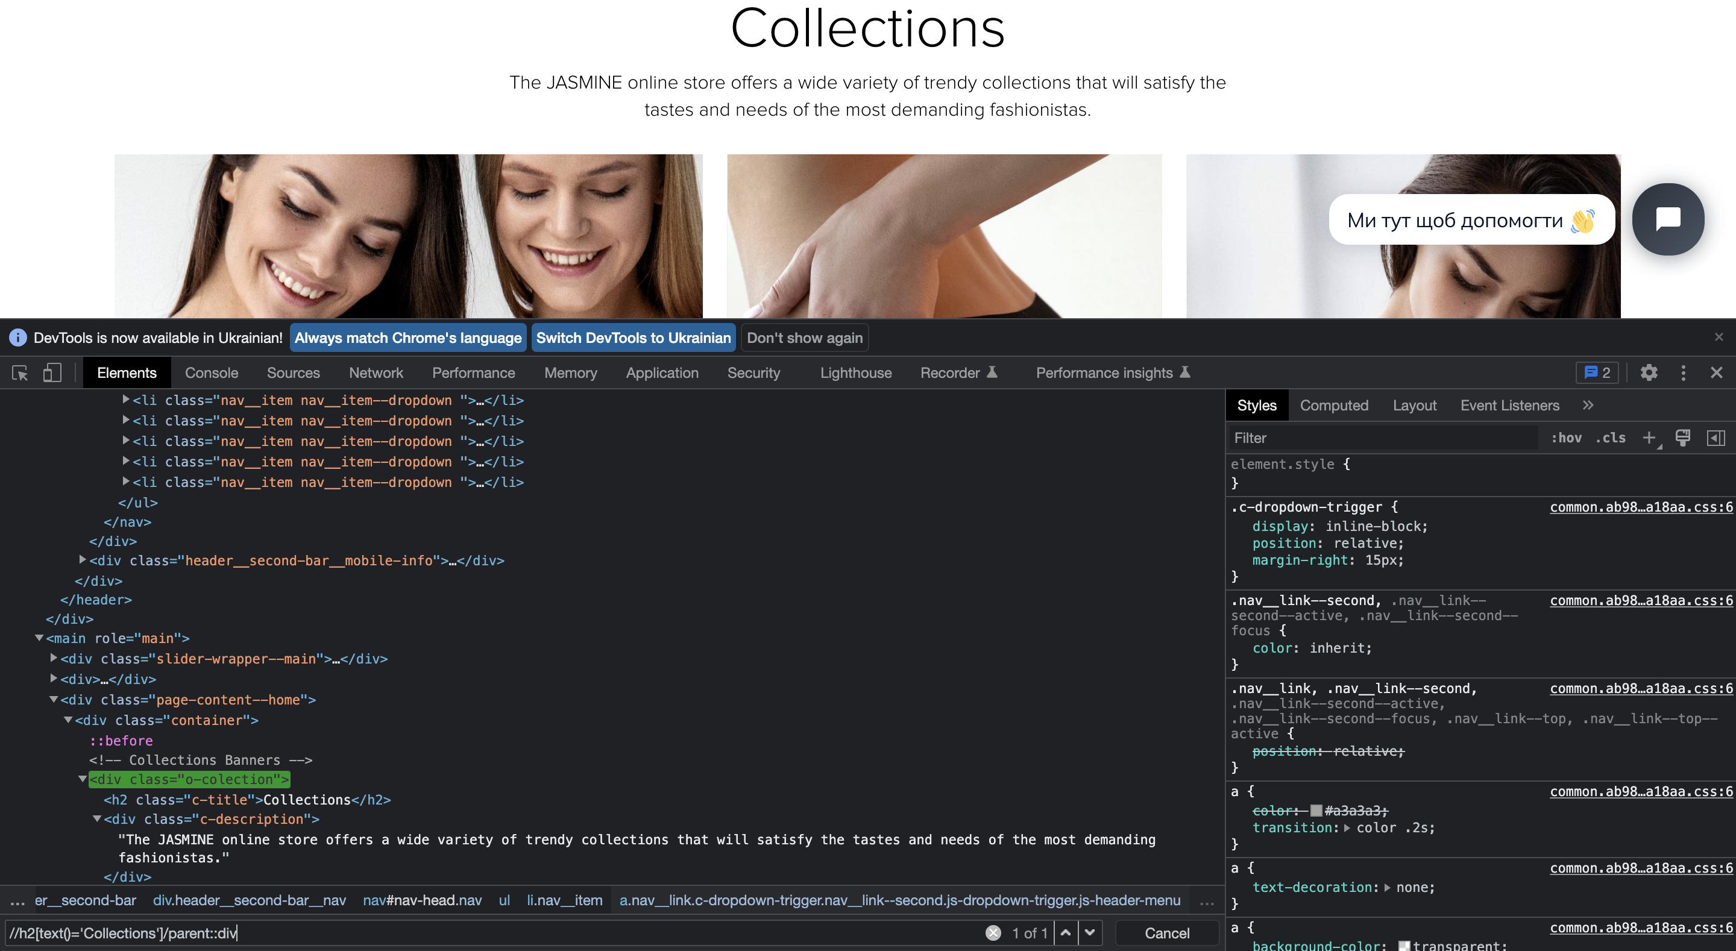
//h2[text()='Collections']/parent::div

Slide 11
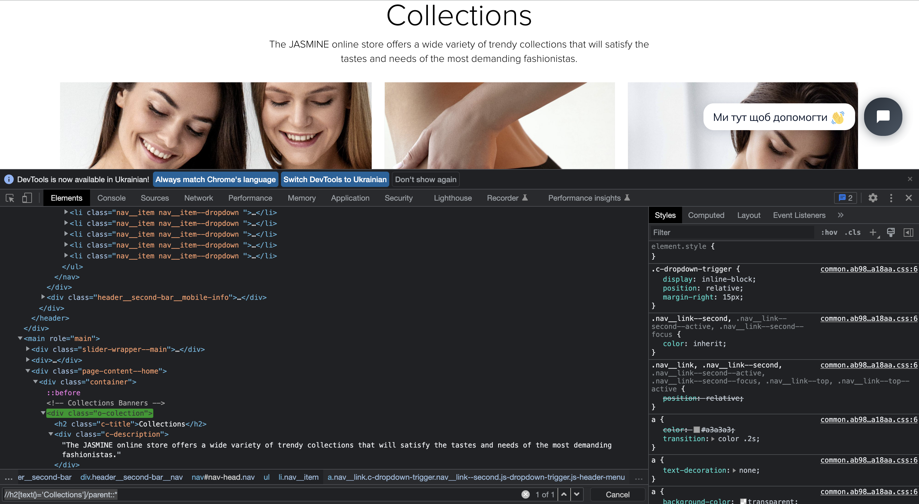
//h2[text()='Collections']/parent::*

Slide 12
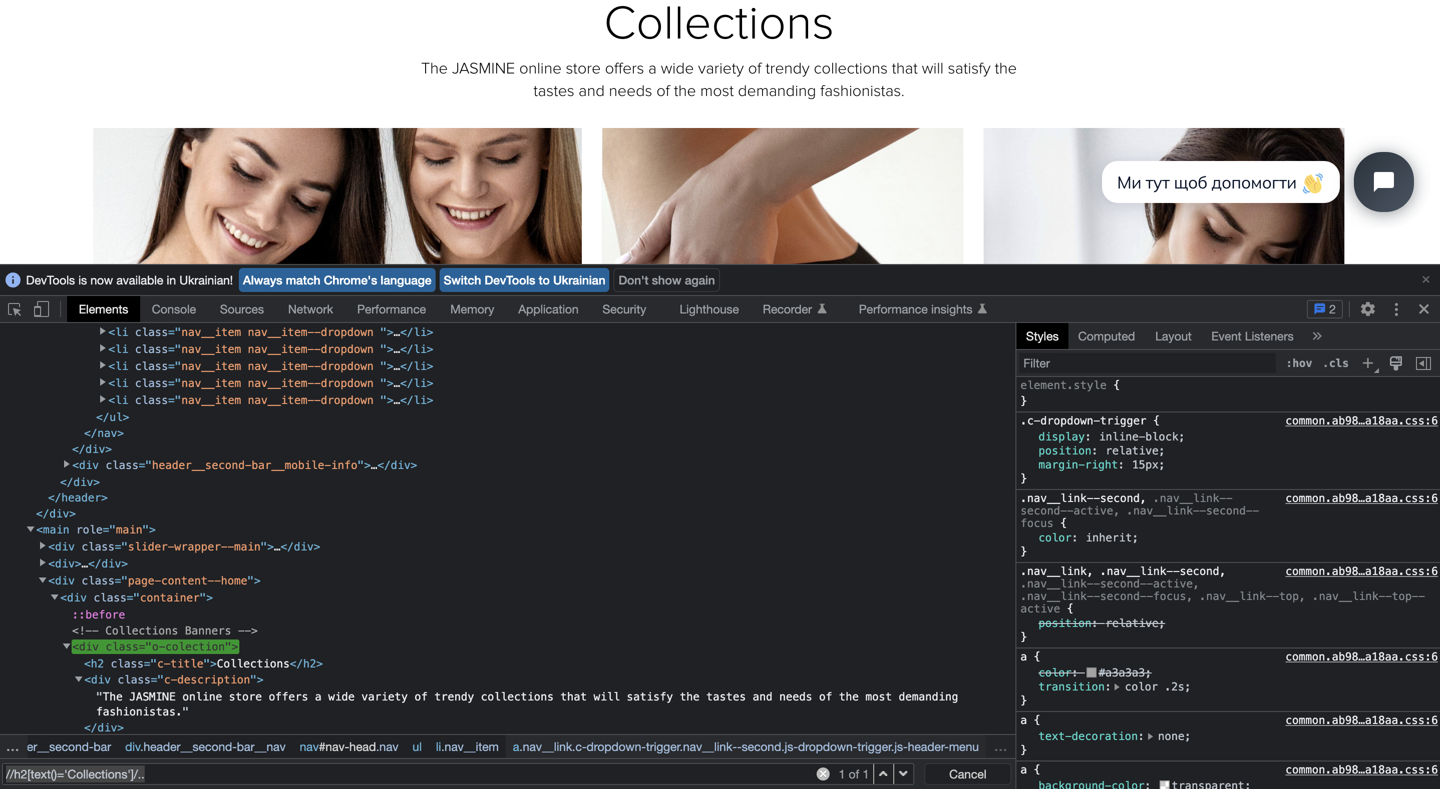
//h2[text()='Collections']/..

Slide 13
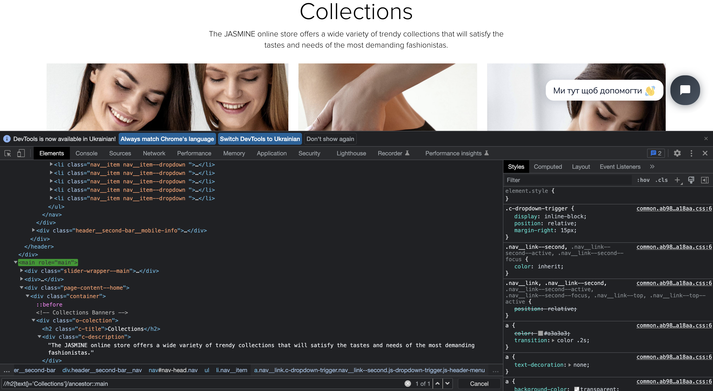
//h2[text()='Collections']/ancestor::main

Slide 14
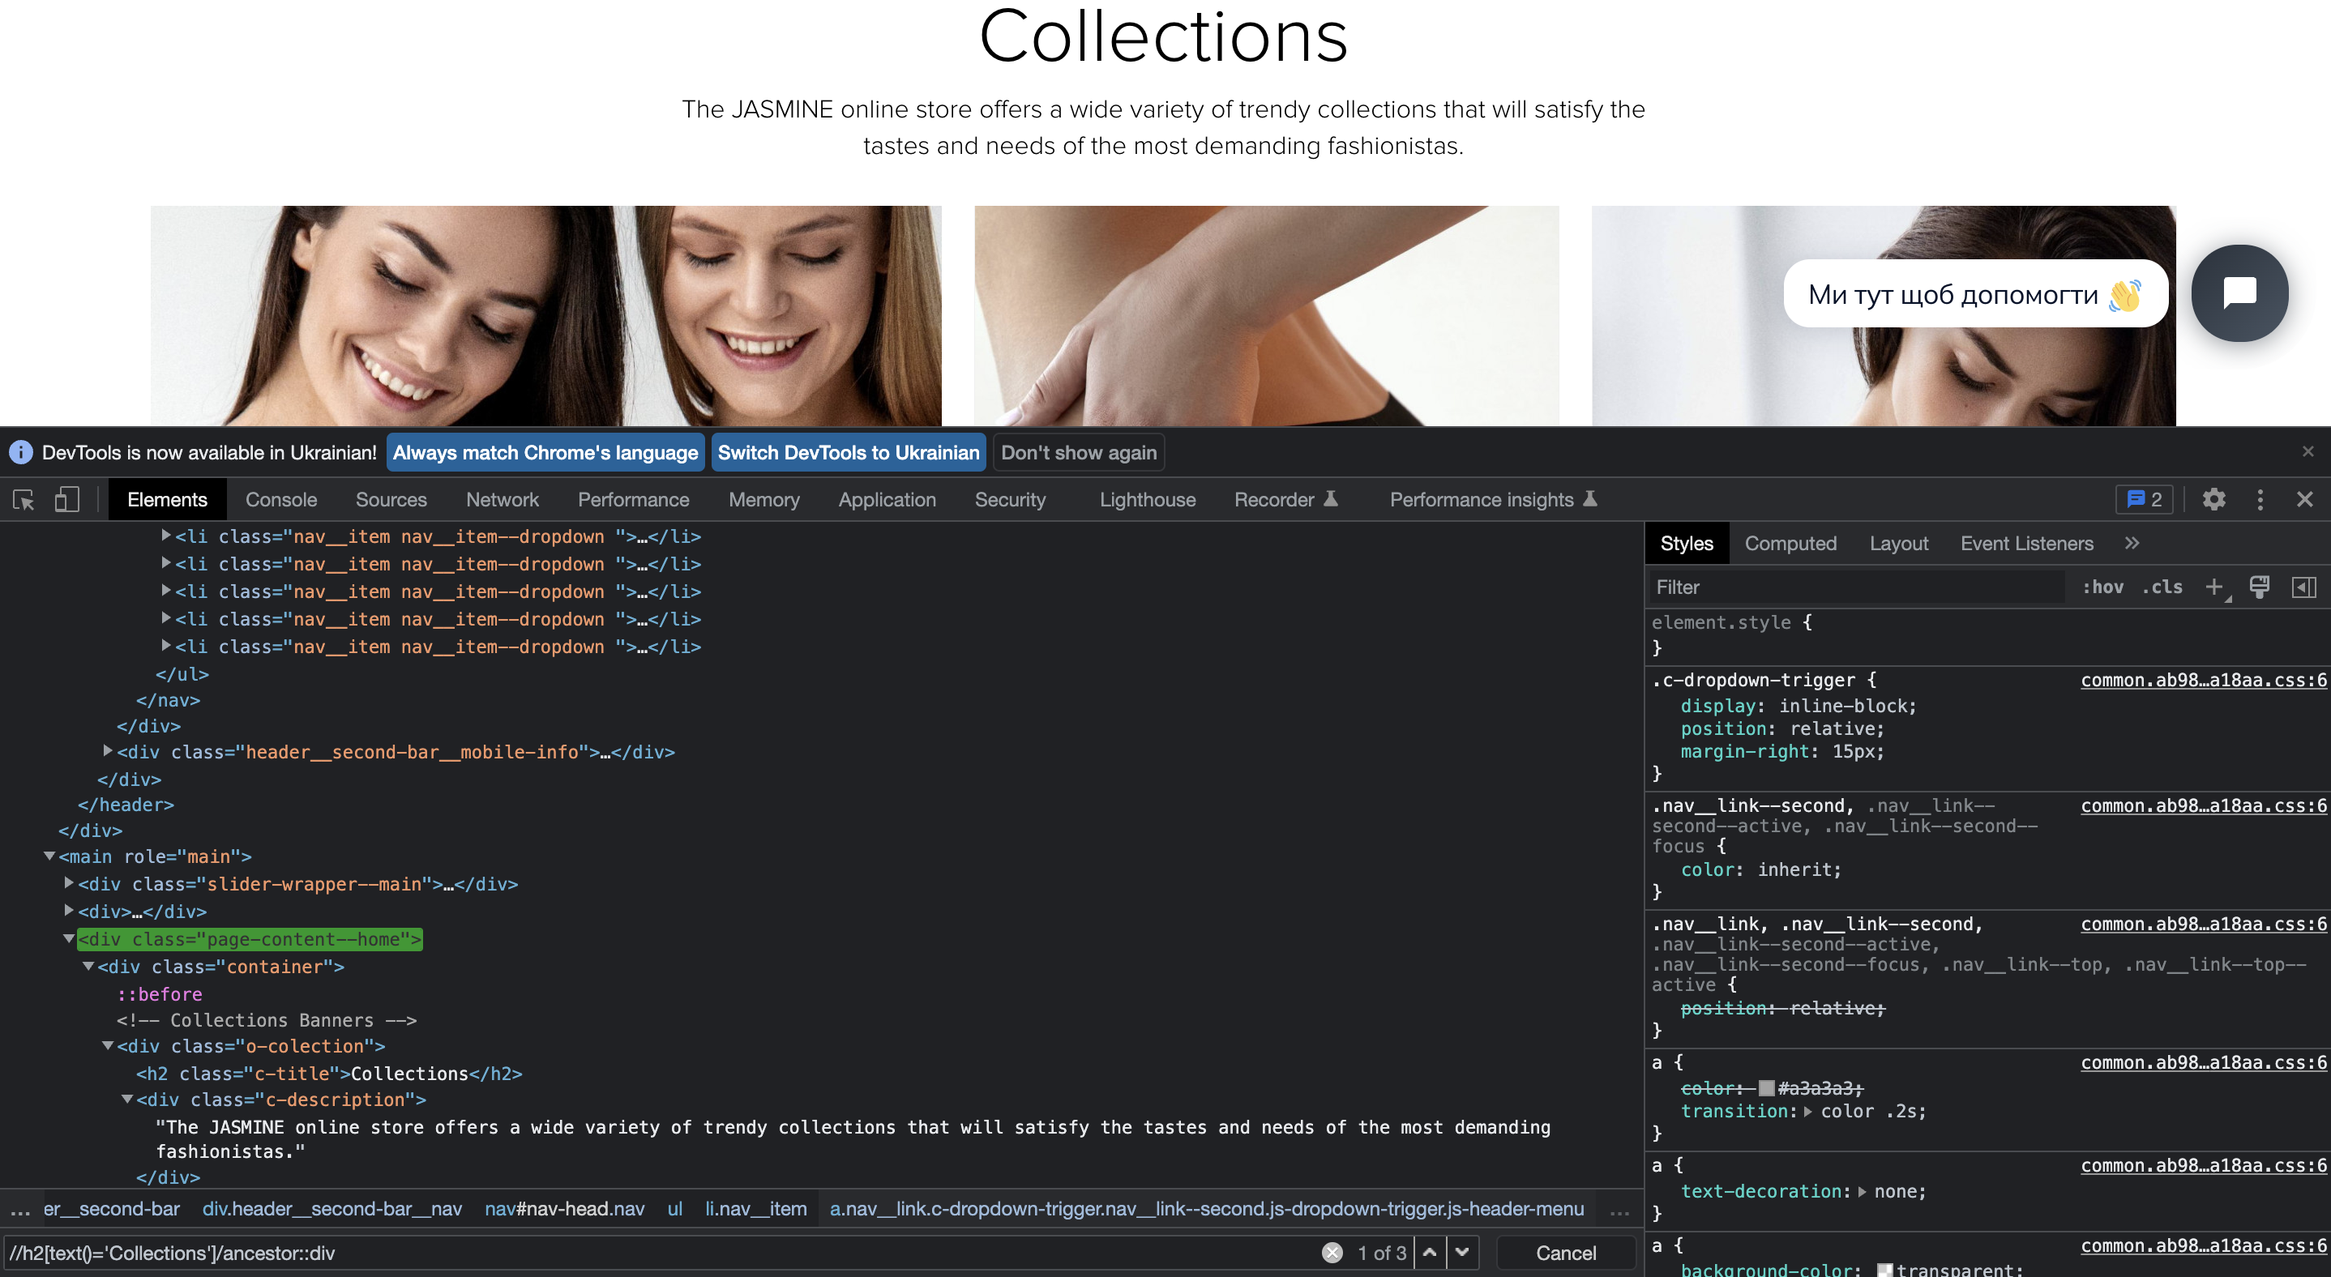
//h2[text()='Collections']/ancestor::div

Slide 15
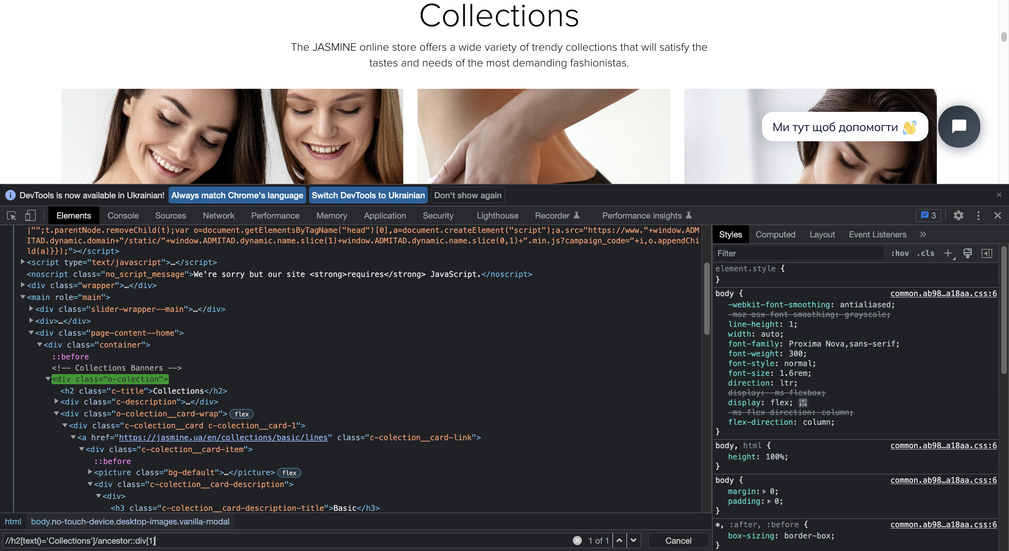
//h2[text()='Collections']/ancestor::div[1]

Slide 16



